Slide 1
Chemistry – Oct 29, 2019
P3 Challenge-
What is the difference between heat and temperature? Explain using the heating curve of water.
Pick up two handouts: Notes page, Homework Assignment
Objective –
Model energy transfers
Agenda –
Energy Bar Charts

Slide 2
Type of Energy
Three Ways to Store Energy
1) Thermal Energy (E_{th}):
The energy stored by movement of particles
Related to both mass & velocity (temperature = kinetic energy)
2) Phase Energy (E_{ph}):
The energy stored by arrangement/interactions between particles
More attracted = decreased energy
3) Chemical Energy (E_{ch}):
The energy stored by chemical bonds

Slide 3
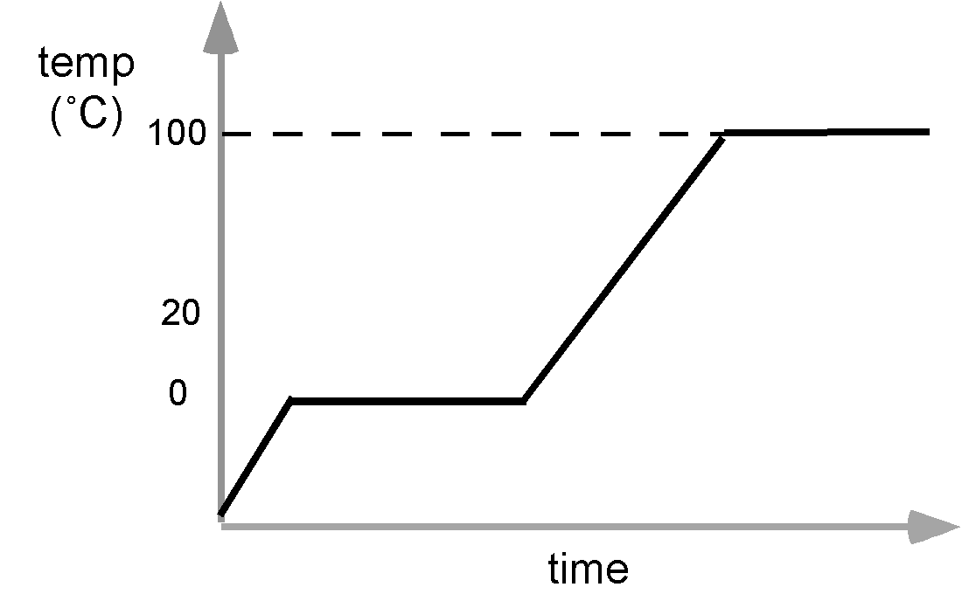
Energy Chart Diagrams
How does the temperature vary when heating ice to water vapor? (Boiling ice lab)
Region A – Low temp plateau
Region B – Temp change
Region C – High temp plateau
C
B
A

Slide 4
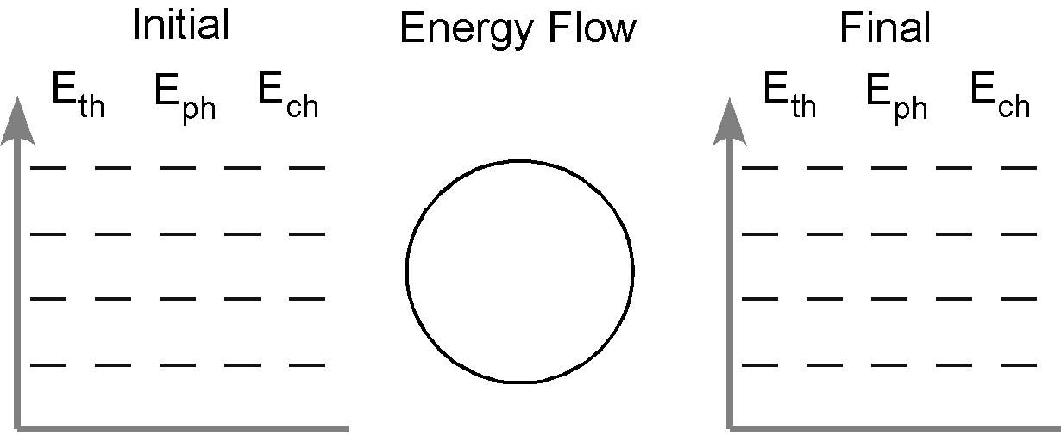
How to use Energy Bar Charts
1) For the initial state: e.g. Room temp water
Draw a bar for thermal energy E_{th} based on the temperature of a substance:
>100C = 4 bars; Hot = 3 bars; RT = 2 bars; Cold = 1 bar; Very cold (<0C) = ½ bar.
Draw a bar for Phase energy E_{ph} based on the state of a substance:
Solids = 1 bar Liquids = 2 bars Gases = 4 bars

Slide 5
How to use Energy Bar Charts
2) For the final state: e.g. hot water
Draw a bar for thermal energy E_{th} based on the temperature of a substance:
>100C = 4 bars; Hot = 3 bars; RT = 2 bars; Cold = 1 bar; Very cold (<0C) = ½ bar.
Draw a bar for Phase energy E_{ph} based on the state of a substance:
Solids = 1 bar Liquids = 2 bars Gases = 4 bars

Slide 6
How to use Energy Bar Charts
Identify the substance by name in the circle which represents the system.
Determine if energy is flowing into the system, or out of the system and how many bar of energy are transferred.
Eg one bar is added to the system.
Represent the energy transfers to or from the system with bars drawn over the edge of the circle with an arrow showing the direction
H₂O

Slide 7
Energy Chart Diagrams
Example:
On the Slope B, the temperature was changing and the system stored E_{th}
On the Plateau C, the phase was changing and the system was storing E_{ph.}
H₂O
H₂O

Slide 8
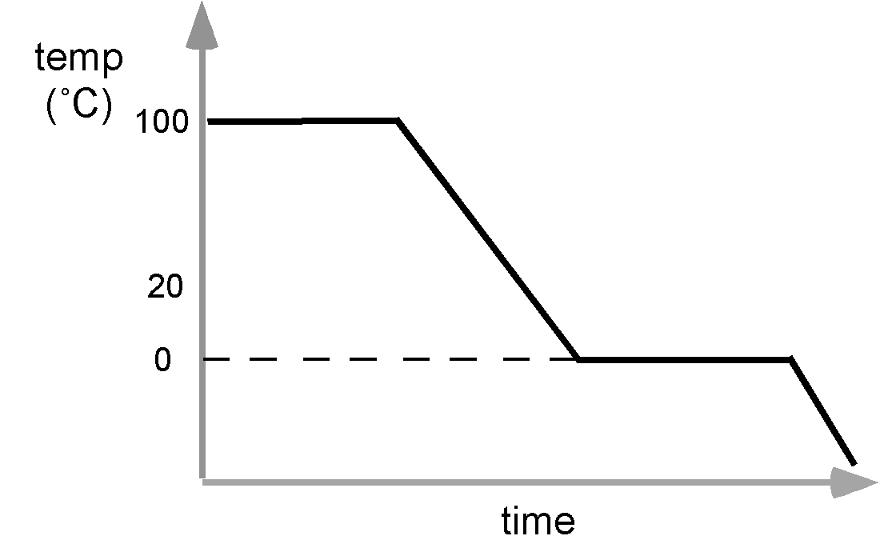
Energy Chart Diagrams
How does energy change when warm humid air freezes on your window in winter?
Particle Explanation: warm water particles in the air cool down to 0 C and then align into a solid.
4 units
Humid
air

Slide 9
Exit Slip and Assignment
Draw an energy bar diagram for blacktop pavement that heats up from 5ºC in the morning to 40ºC in the afternoon.
What’s Due? (Pending assignments to complete.)
Energy Charts Worksheet
What’s Next? (How to prepare for the next day)
Energy, p38-45

